Slide 1

Insights
Module 2 Week 1

Slide 2
Agenda
Document DB - Code Walkthrough
Key-Value DB – Twitter Case Study
Wide Column DB – Netflix Case Study
Graph DB : eBay Case Study

Slide 3
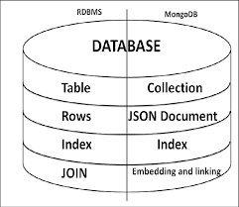
RDBMS vs MongoDB

Slide 4
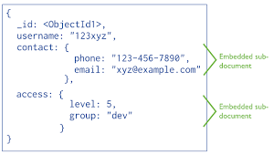
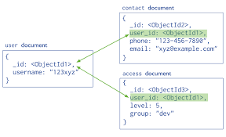
MongoDB Data Model

Slide 5
Code Walkthrough

Slide 6
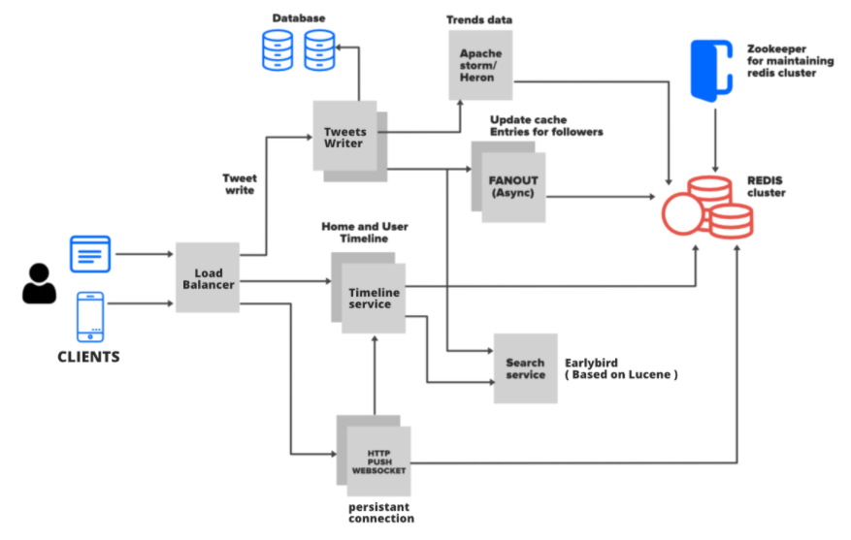
Twitter Time lines – Read Heavy

Slide 7
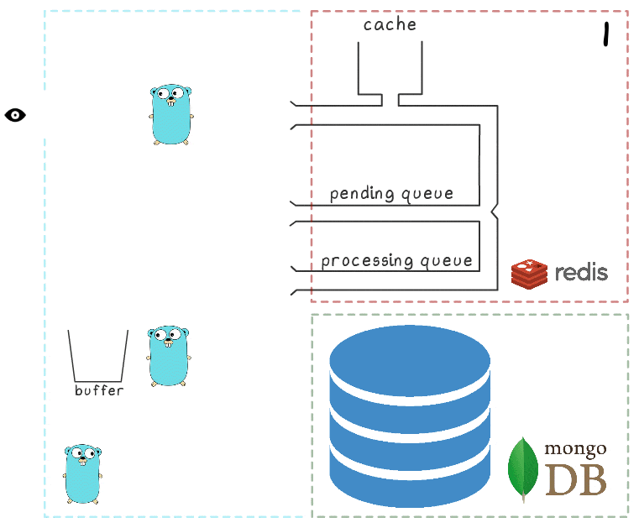
Redis – Stability

Slide 8
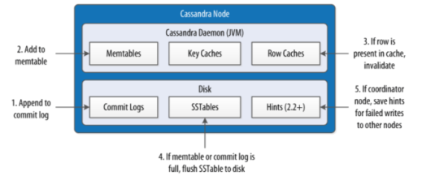
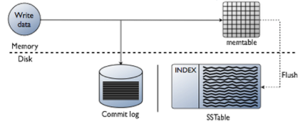
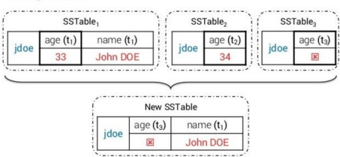
Cassandra

Slide 9
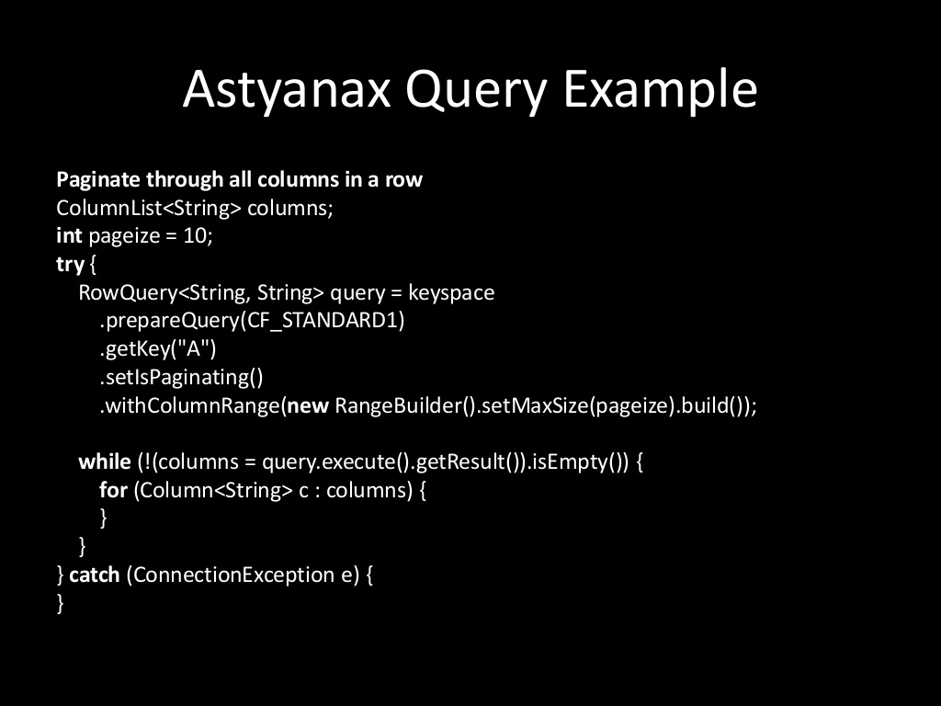
Notes:
https://www.datastax.com/

Slide 10
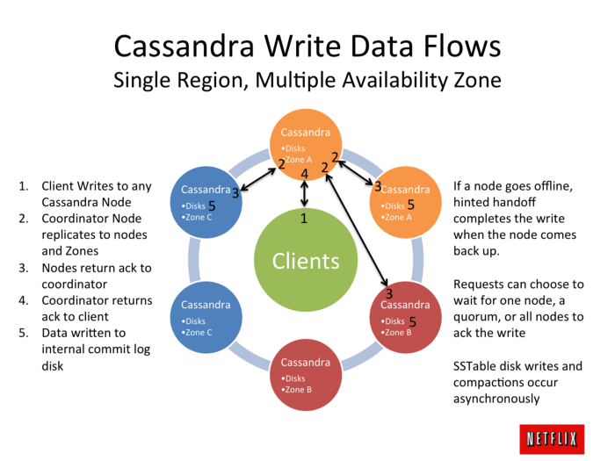
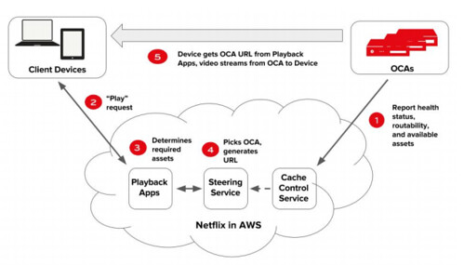
Netflix – Write Heavy

Slide 11
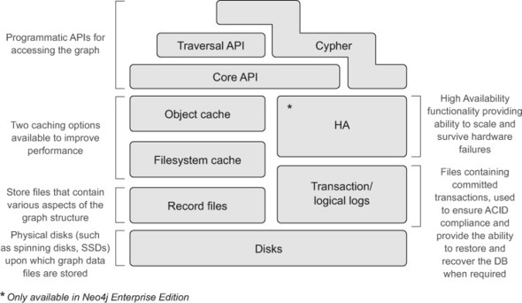
Neo4j

Slide 12
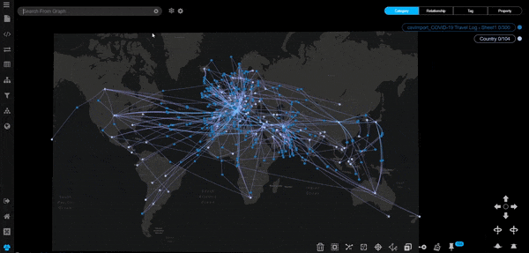
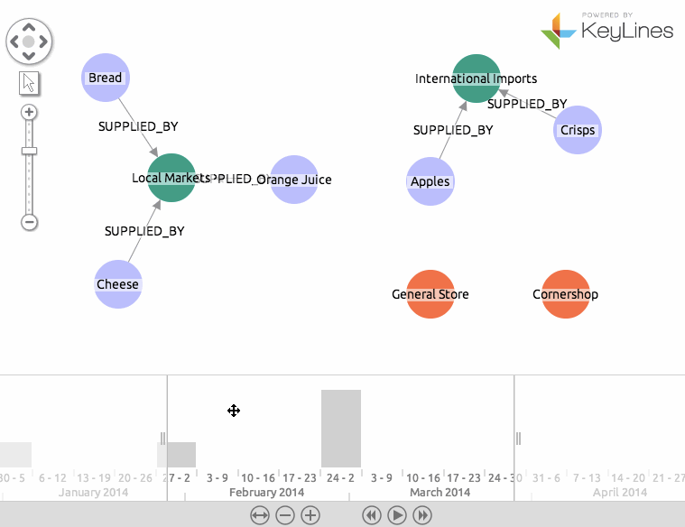
Neo4j

Slide 13
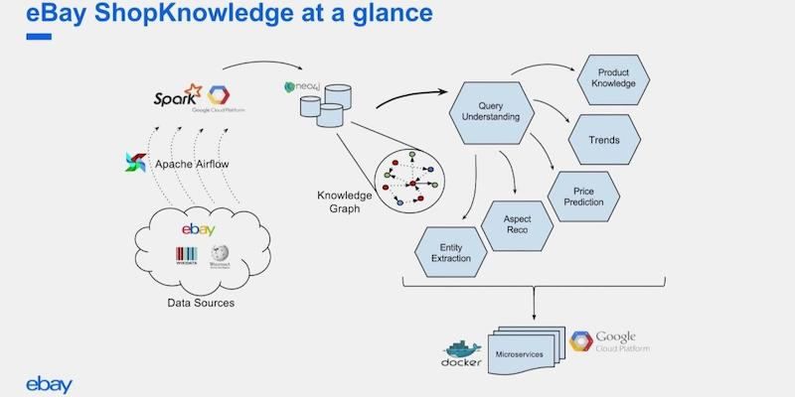
eBay – Knowledge Graph

Slide 14
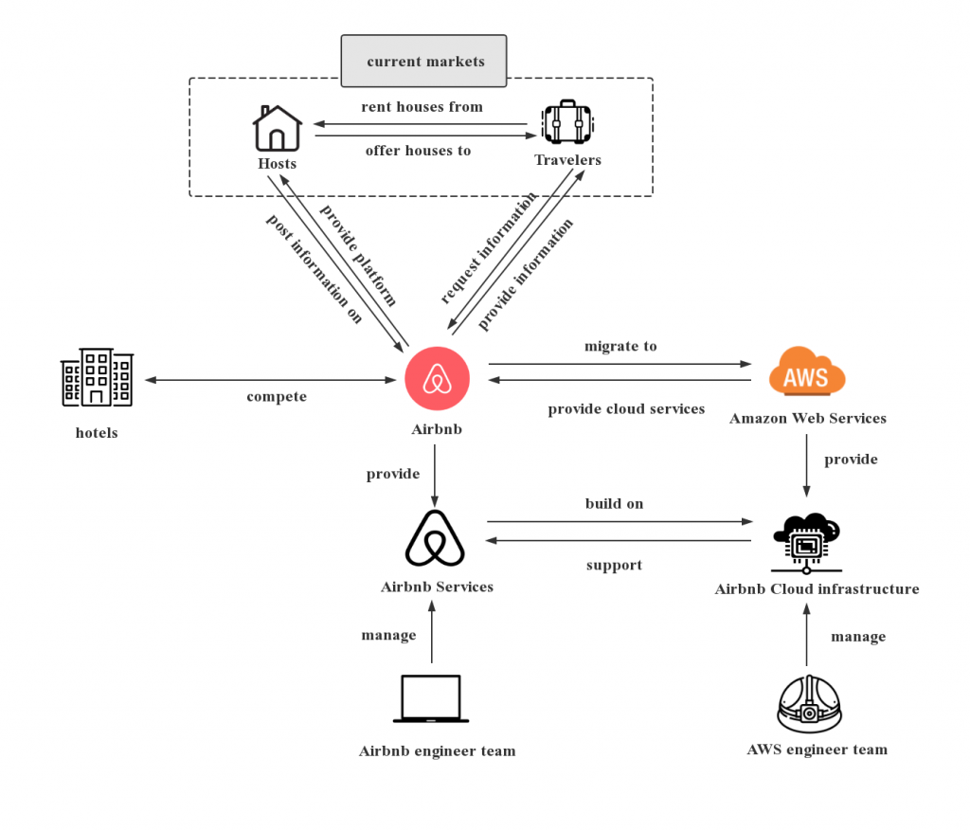
Airbnb

Slide 15
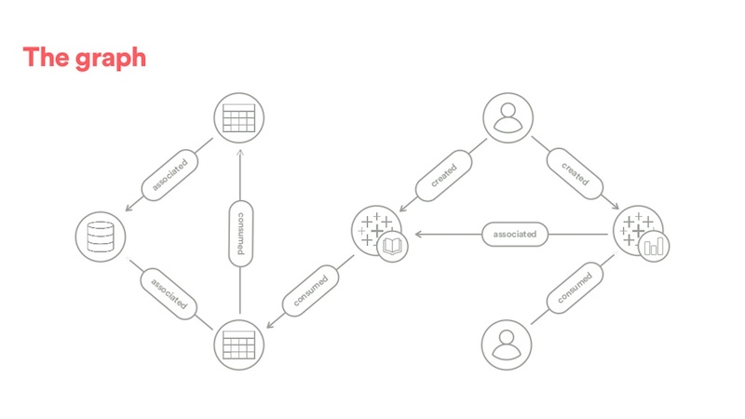
Airbnb Contextualization – Knowledge Graph

Slide 16
References
https://www.infoq.com/presentations/Twitter-Timeline-Scalability/
https://netflixtechblog.com/astyanax-retiring-an-old-friend-6cca1de9ac4
https://docs.datastax.com/en/developer/java-driver/4.13/
https://medium.com/@sawomirkowalski/design-patterns-builder-fluent-interface-and-classic-builder-d16ad3e98f6c
https://netflixtechblog.com/benchmarking-cassandra-scalability-on-aws-over-a-million-writes-per-second-39f45f066c9e
https://netflixtechblog.com/revisiting-1-million-writes-per-second-c191a84864cc
https://neo4j.com/blog/democratizing-data-discovery-airbnb/
https://medium.com/airbnb-engineering/contextualizing-airbnb-by-building-knowledge-graph-b7077e268d5a
https://medium.com/airbnb-engineering/scaling-knowledge-access-and-retrieval-at-airbnb-665b6ba21e95
https://neo4j.com/sandbox/?ref=developer-start
https://netflixtechblog.com/
https://www.mongodb.com/docs/manual/reference/operator/query/or/
https://github.com/mongodb/mongo-python-driver
https://microservices.io/patterns/microservices.html
https://github.com/donnemartin/system-design-primer
https://blog.container-solutions.com/what-is-eventual-consistency-and-why-is-it-so-cool
https://www.mongodb.com/docs/v4.4/tutorial/getting-started/

